Slide 1

Data Analysis and Visualization
This presentation covers data analysis and visualization tasks using Tableau
by James Dark

Slide 2
Tableau Versions Compared
Tableau Prep
Tableau Desktop
Tableau Cloud
Tableau Server
A modern approach to data
preparation that makes it
easier and faster to combine,
shape, and clean data for
analysis.
Paid version with wider
data connectivity.
Private workbooks.
Unlimited data rows.
Experience a fully hosted,
cloud-based, AI-powered
solution on the world’s
#1 analytics platform.
Self-deploy Tableau for
unmatched control and flexibility
on-premises or in public cloud.
Tableau Public
Free version with limited data sources.
Workbooks are public.
Data limit of 1 million rows.

Slide 3
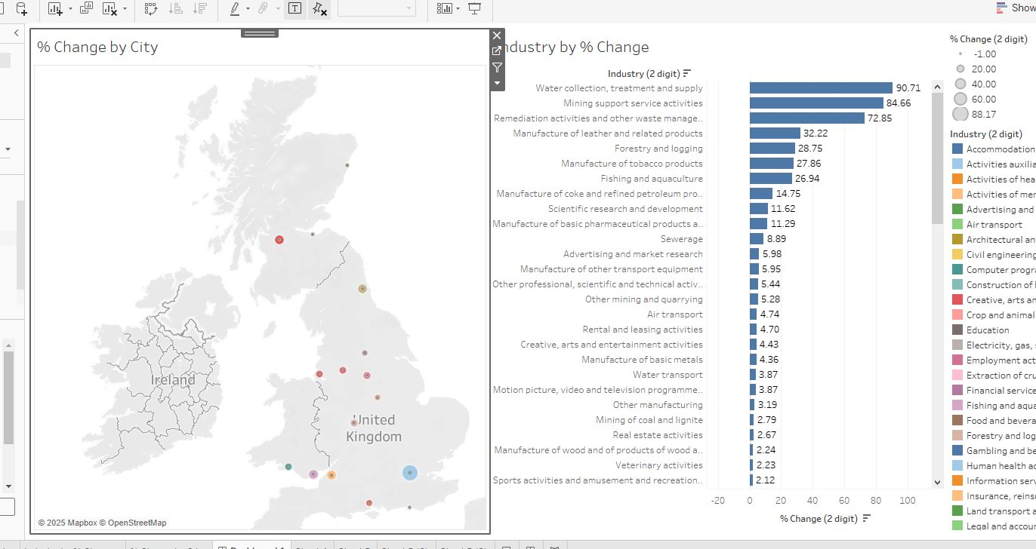
EMSI Job Change Dashboard
1
Bar Chart
2
UK Map
Shows percentage change.
Highlights key city locations impacted.

Slide 4
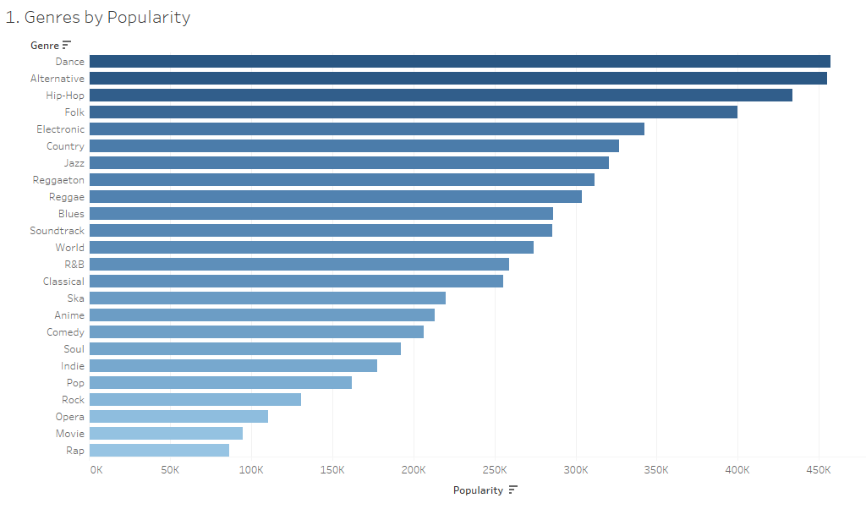
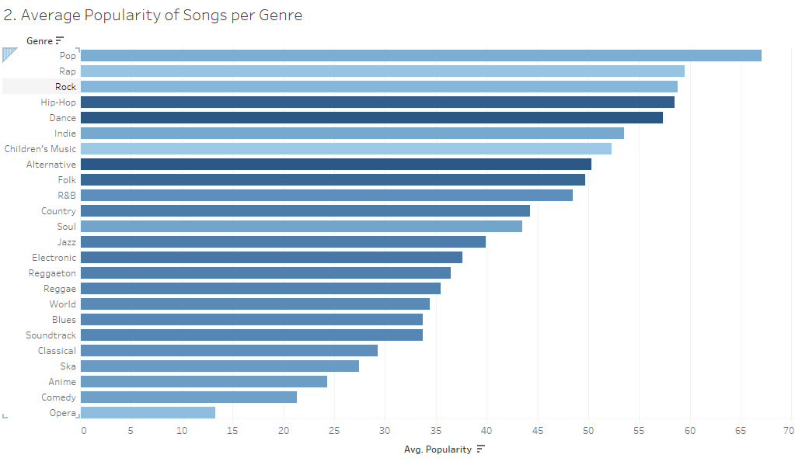
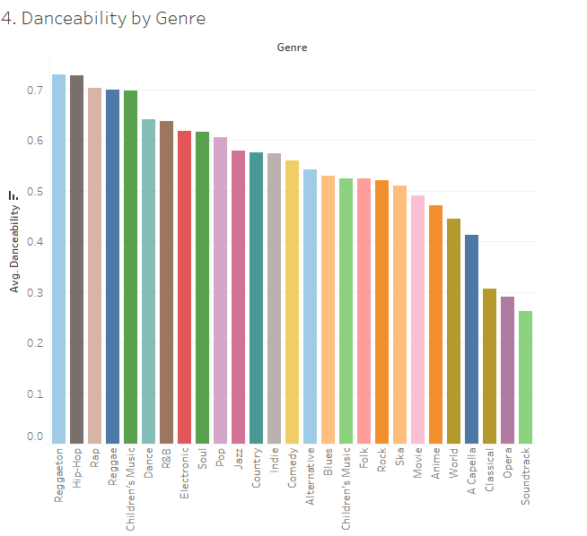
Spotify Data Analysis
Most Popular Genre
Average Popularity
Danceability
Dance is the most popular.
Pop moves into the top spot.
Hip-Hop is high in danceability.

Slide 5

Health Data Analysis
1
Data-Driven Decisions
Supports decision-making.
2
NHS Support
Trends and key information.

